Slide 1
Comprehensive Comparative Analysis of
Emotional Support Delivery by NAO Robots
and Humans Across Varied Emotional States
Teachers
Dr. Lafifa Jamal
Professor
Department of Robotics and Mechatronics Engineering
University of Dhaka
Shifat-E-Arman
Lecturer
Department of Robotics and Mechatronics Engineering
University of Dhaka
Presented By
Rabeya Akter
Roll: SK-092-015
Safaeid Hossain Arib
Roll: FH-092-020
Tapos Biswas
Roll: JN-092-004

Slide 2
Introduction

Slide 3

Emotional Support
Fig : Emotional Support [1]

Slide 4
Motivation

Slide 5

Humans Clouding Interactions
Fig : Humans being Judged by Humans [2]

Slide 6

Can Robots be Our Emotional Companion?
Fig : Robots Providing Emotional Support [3]

Slide 7
Literature Review

Slide 8
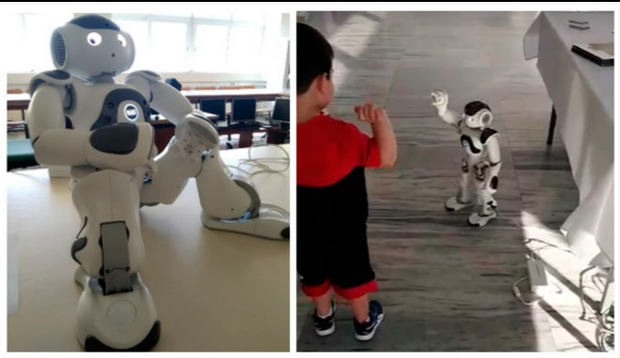
Emotion recognition in human–robot interaction using
the nao robot [4]
Fig : (a) The humanoid robot NAO {b} NAO greeting a child [4]
[4] I. A. Valagkouti, C. Troussas, A. Krouska, M. Feidakis, and C. Sgouropoulou, “Emotion recognition in human–robot interaction using
the nao robot,” Computers, vol. 11, no. 5, p. 72, 2022.

Slide 9
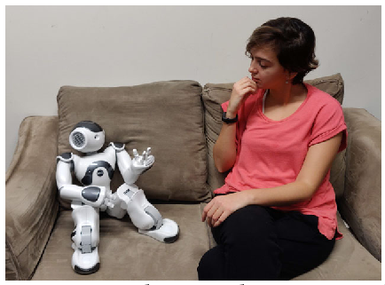
Emotional Support Domestic Robots for Healthy Older Adults:
Conversational Prototypes to Help With Loneliness [5]
Fig : A person sits at home with an emotional support robot and has a conversation about their day. [5]
[5] A. N. Baecker, D. Y. Geiskkovitch, A. L. Gonz ́alez, and J. E. Young, “Emotional support domestic robots for healthy older adults: Conversational prototypes to help with loneliness,” in Companion of the 2020 ACM/IEEE International Conference on Human-Robot Interaction, pp. 122–124, 2020

Slide 10
Problem Statement

Slide 11
Effectiveness Comparison: NAO vs. Humans - Who provides better emotional support?
Perceived Empathy: How do people feel about NAO robot vs. human support?
Preference Factors: Why do individuals choose NAO or humans for support?

Slide 12
Methodology

Slide 13
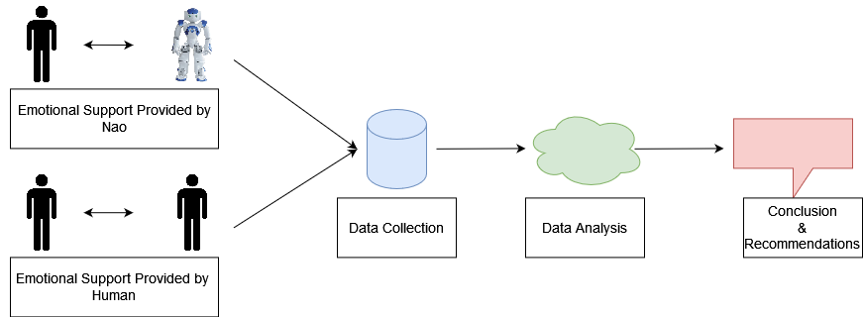
Overall Methodology
Fig : Overall Methodology [Drawn in draw.io]

Slide 14
Emotions
1. Happy
2. Sad
3. Fear
4. Excitement

Slide 15
Emotional Support by NAO Based on Happy Emotion
Happiness
□ Conveying a sense of joy and positivity.
□ Wave or give a friendly gesture to celebrate.
□ Play cheerful music or engage in a dance routine to uplift spirits.

Slide 16
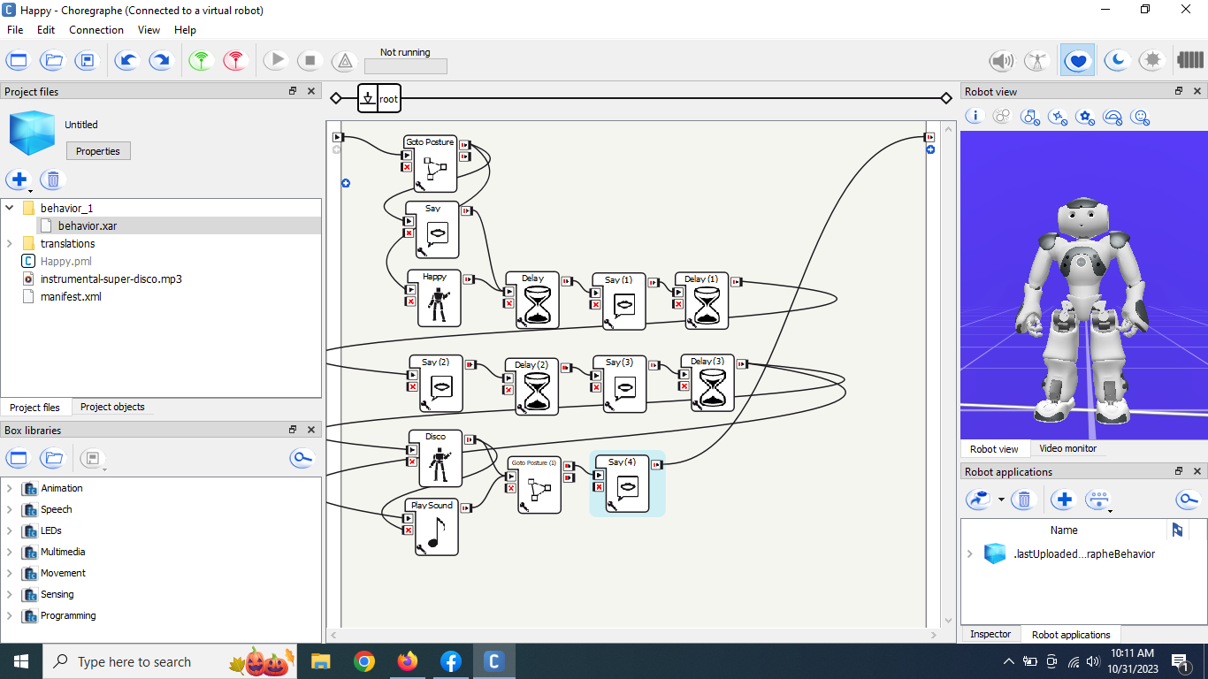

Slide 17
Emotional Support by NAO Based on Sad Emotion
Sadness
□ Offer a comforting gestures.
□ Play soothing music or dance to uplift participants mood.
□ Provide gentle words of encouragement and empathy.

Slide 18
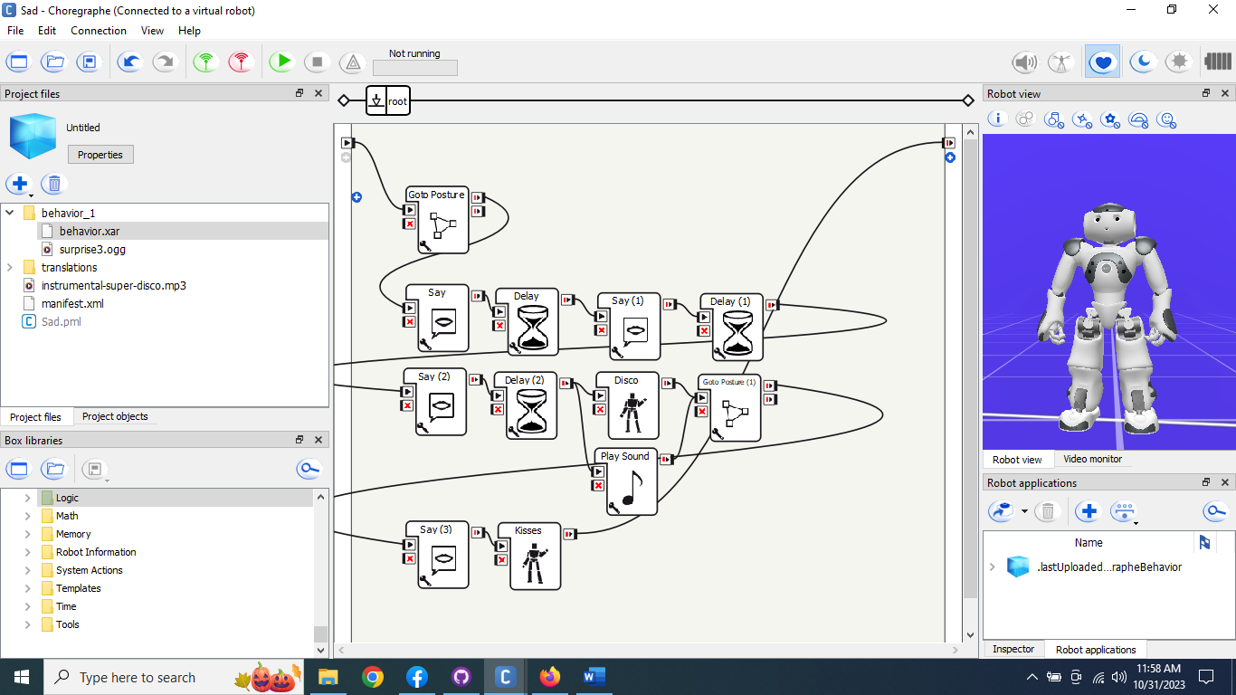

Slide 19
Emotional Support by NAO Based on Fear Emotion
Fear
□ Use a reassuring tone of voice to calm anxiety.
□ Stand still or offer a hand to hold for stability.

Slide 20
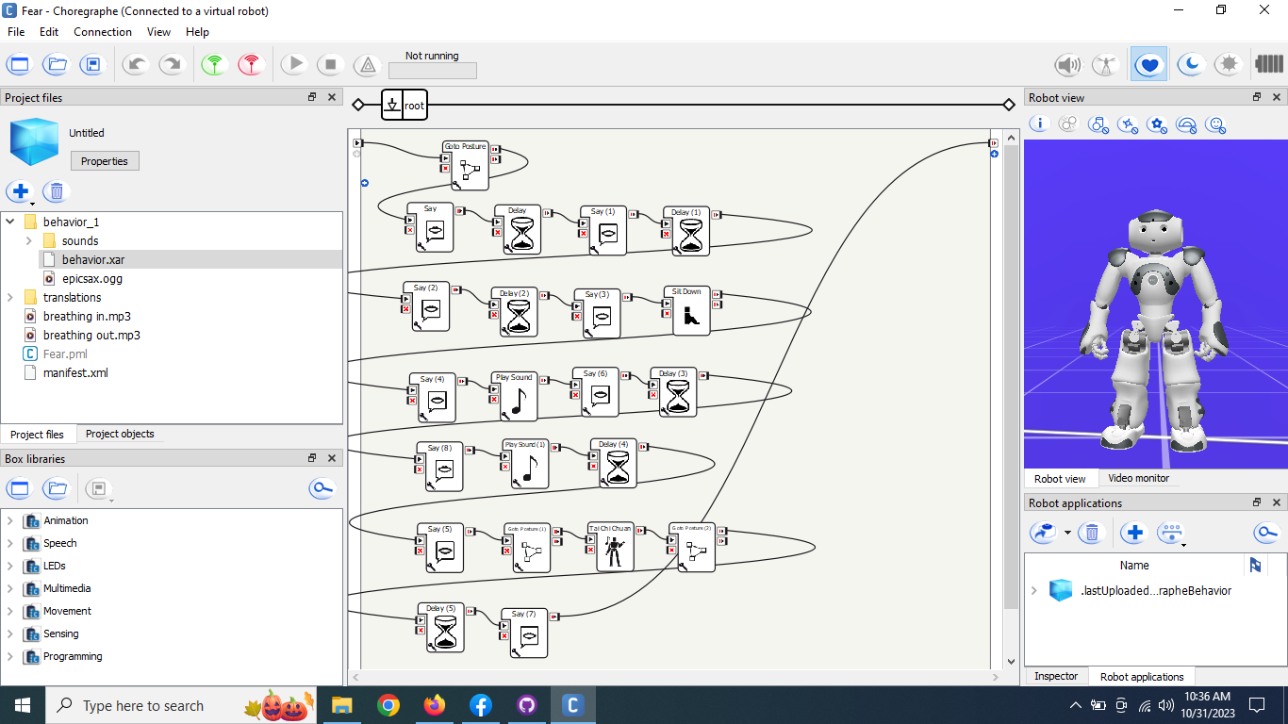

Slide 21
Emotional Support by NAO Based on Surprised Emotion
Excitement
□ Display an element of curiosity.
□ Engage in a dynamic, inquisitive movement or gesture.
□ Offer a friendly explanation or reassurance, helping to process the surprise.

Slide 22
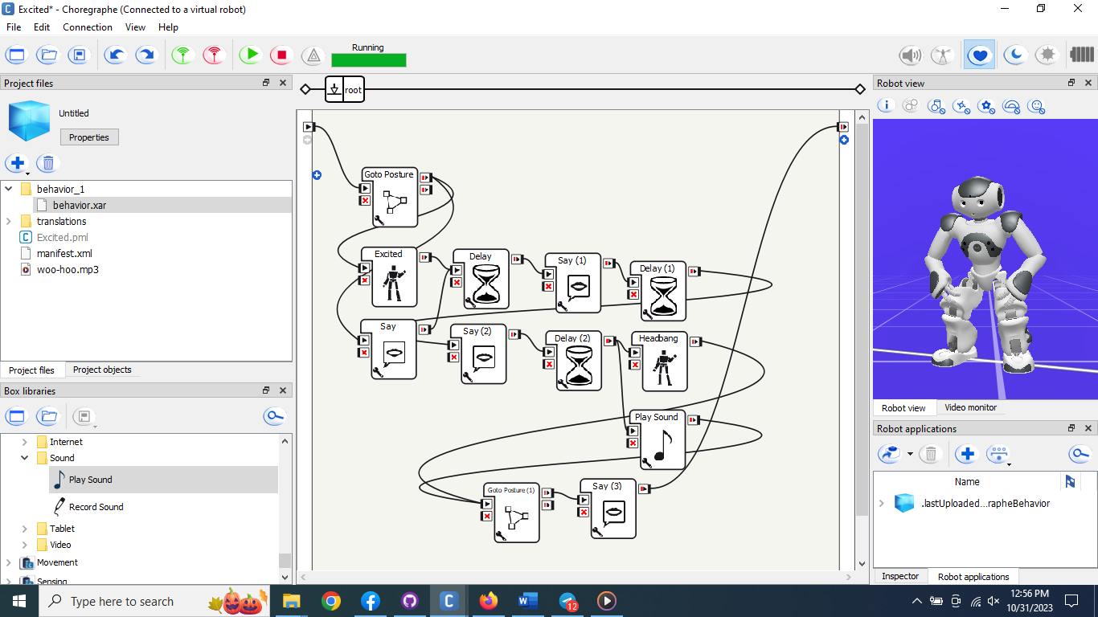

Slide 23
Total Participants Needed : 48
For Happiness, Participants:
From the department : 6
From outside the department : 6
_____________________________
Total : 12
For Sadness, Participants:
From the department : 6
From outside the department : 6
_____________________________
Total : 12

Slide 24
Total Participants Needed : 48
For Fear, Participants:
From the department : 6
From outside the department : 6
_____________________________
Total : 12
For Excitement, Participants:
From the department : 6
From outside the department : 6
_____________________________
Total : 12

Slide 25
Questionnaires
Demographic Information
Emotional Impact
Comfort
Communication and Interaction
Overall Satisfaction
Personal Preference
Additional Feedback

Slide 26
Expected Work to be Done

Slide 27
Data Collection: Questionnaires ready; Data gathering from participants pending.
Data Analysis: Examination of questionnaire and observation data.
Comparative Analysis: Assess NAO robots vs. human emotional support using statistical methods.
Conclusions & Recommendations: Draw conclusions, identify strengths, and formulate enhancement recommendations.

Slide 28
References
[1] https://www.painscale.com/article/providing-emotional-support-without-problem-solving
[2]https://timesofindia.indiatimes.com/life-style/relationships/love-sex/do-you-judge-people-too-quickly-heres-what-you-should-do-to-avoid-that/articleshow/64274246.cms
[3] https://www.analyticsinsight.net/emotional-robots-can-robots-emotional-companion/
[4] I. A. Valagkouti, C. Troussas, A. Krouska, M. Feidakis, and C. Sgouropoulou, “Emotion recognition in human–robot interaction using the nao robot,” Computers, vol. 11, no. 5, p. 72, 2022.
[5] A. N. Baecker, D. Y. Geiskkovitch, A. L. Gonz´alez, and J. E. Young, “Emotional support domestic robots for healthy older adults: Conversational prototypes to help with loneliness,” in Companion of the
2020 ACM/IEEE International Conference on Human-Robot Interaction, pp. 122–124, 2020.

Slide 29
Thank You

